Slide 1


ABC Corporation
Customer Satisfaction Improvement Program
Planning -- Appendix
May 28, 19xx
- DRAFT -
Copyright © by Deloitte & Touche Consulting Group, 19xx.
This report is solely for the use of client personnel. No part of it may be circulated, quoted, or reproduced for distribution outside of the client organization without prior written approval from Deloitte & Touche Consulting Group.
Notes:
1

Slide 2
Contents
Page
Example Deliverables 2
  Business Needs and Direction 4
  Internal Assessment 10
  External Assessment 15
  Project Descriptions 19
  Strategic Alignment Analysis 22
  Portfolio Cost Benefit Summary 24
  Portfolio Prioritization
    Prioritization Framework 26
    Project Interdependencies Matrix 28
  Portfolio Plan & Resource Schedule 30
Example Questions for interviews 32

Slide 3
Appendix
Example Deliverables

Slide 4
Business Needs and Direction
Deliverable Objective:
Understand the mission and objectives of the enterprise from a business unit perspective. This understanding is used to ensure that the IT Strategy meets the business needs.
Deliverable Components:
Business objectives, critical success factors, and assumptions
Business purpose and direction
Key Considerations for Deliverable Development
The components of this deliverable should be considered at the business unit level, understanding the enterprise impact.
The focus is to describe the business, not information technology matters. Also attempt to understand the business strategy in terms of levels within the organization.
The purpose of investigating the business strategy is to document and understand the business strategy as a foundation for an Information Systems strategy, not to develop the business strategy itself.

Slide 5
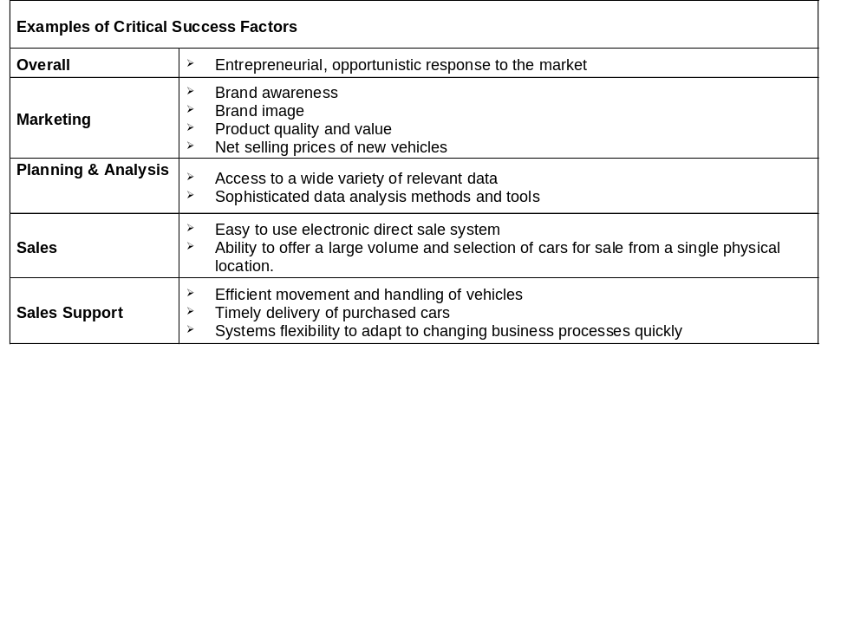
Business Needs and Direction
Examples of Business Unit Objectives
Encourage the purchase of new vehicles
Maximize net realized prices for remarketed vehicles
Provide cost-effective and convenient supply of used vehicles to dealers
Boost officially reported values for used vehicles sold through auctions

Slide 6
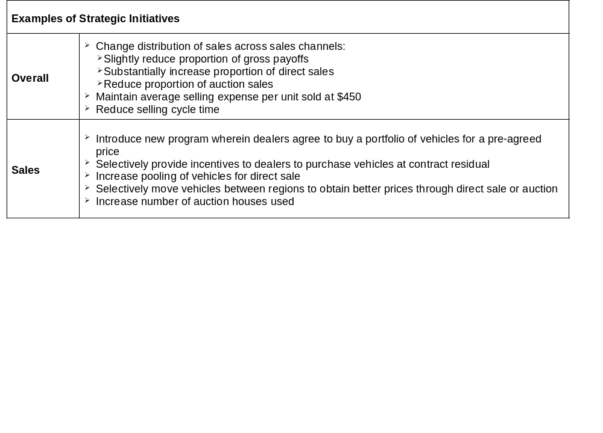
Business Needs and Direction
Examples of Current Strategies
Remarket all vehicles (off-lease, fleet, and company vehicles) except repossessed vehicles.
Intensively communicate with lessees prior to the termination of a vehicle lease to encourage the purchase of a new vehicle.
Conduct the end of lease process (grounding) at a dealership.
Have dealer inspect vehicle at grounding in presence of customer to identify damage.
Have professional inspector inspect vehicle subsequently to identify damage and assign dollar values.
Move selected vehicles to one of four marshaling yards
Offer attractive rates to ship vehicles from marshaling yards to a purchasing dealer.
Optimally allocate vehicles through these existing sales channels: gross payoffs, direct sales, and closed and open auction sales.
Price vehicles for direct sale to: not discourage dealer gross payoffs, maximize realized value, and avoid auction expenses.

Slide 7
Business Needs and Direction
Examples of Possible Future Strategies
Retail - Offer cars directly to consumers through a newly created entity.
Remarketing as a weapon:
  Acquire more cars by reducing the number of gross payoffs
  Ration available remarketed vehicles to better, higher paying dealers
  Improve marketing - spend money to support dealers
Variants of portfolio purchase:
  Sell to any and all possible buyers
  Sell through pure auction, possibly electronic
  Use contractual agreement and 3rd party inspector to adjust agreed prices based on actual mileage and condition.

Slide 8
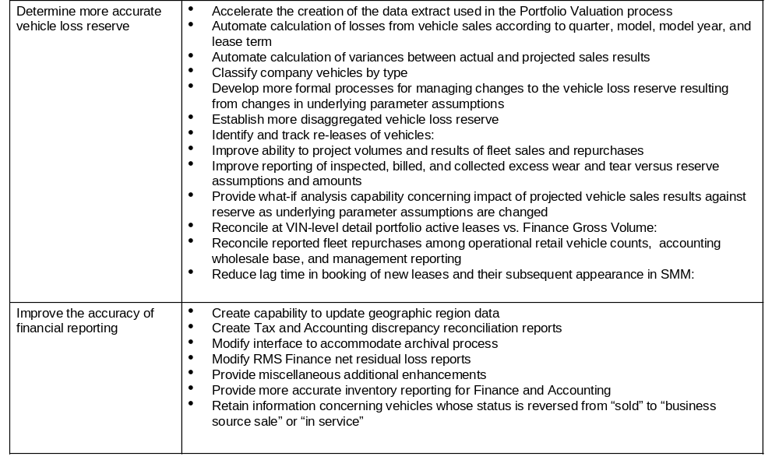
Business Needs and Direction
Example of Requirements Detail
Finance

Slide 9
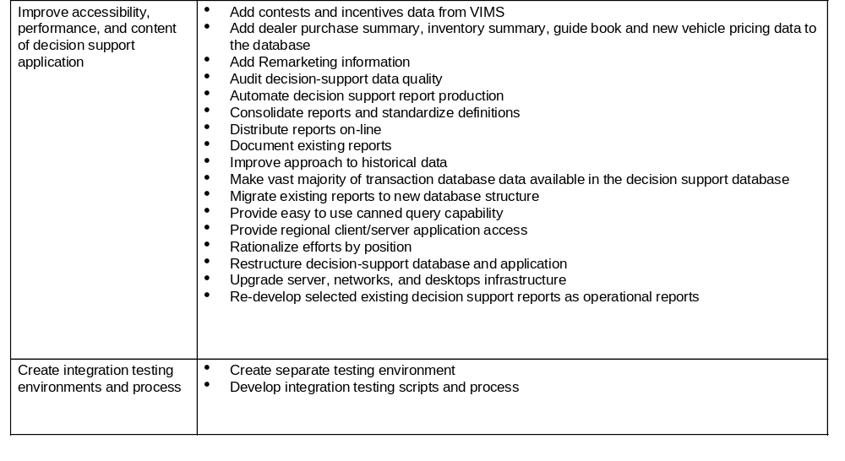
Business Needs and Direction
Example of Requirements Detail
Systems Infrastructure

Slide 10
Internal Assessment
Deliverable Objective:
Inventory and evaluate the business utility and technical quality of the current information systems and to evaluate the history, direction, structure, and function of the IS organization. The deliverable is important in defining the scope, objectives, and priorities of future development projects, and in defining a practical migration path from current systems to future systems.
Deliverable Components:
Inventory of current applications, databases, and technology
Evaluation of current information systems
Evaluation of project inventory
Key Considerations for Deliverable Development
Identify and describe the current application systems, databases, and technology and the respective relationships to business functions, organization units, and location types
After creating an inventory of the current applications, databases, and technology, evaluate it against a set of criteria to assess the functional and technical quality
  Functional quality refers to how information systems appears to users and how well they support the actions and objectives of the organization
  Technical quality refers to how information systems appear to systems professionals (ex. expense to run, difficulty to maintain)
The evaluation criteria should be in alignment with the business strategy and technical direction
When evaluating the project inventory and its alignment with the business and technical strategy, it is important to understand the potential impact of the effort and determine one of three appropriate steps: continue the project as-is, reduce the scope, or cancel the project.

Slide 11
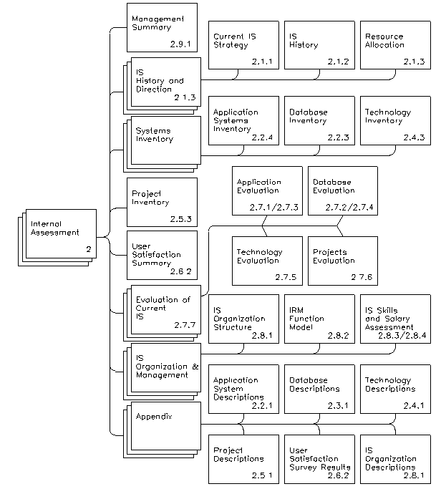
Internal Assessment
Example Outline of an Internal Assessment

Slide 12
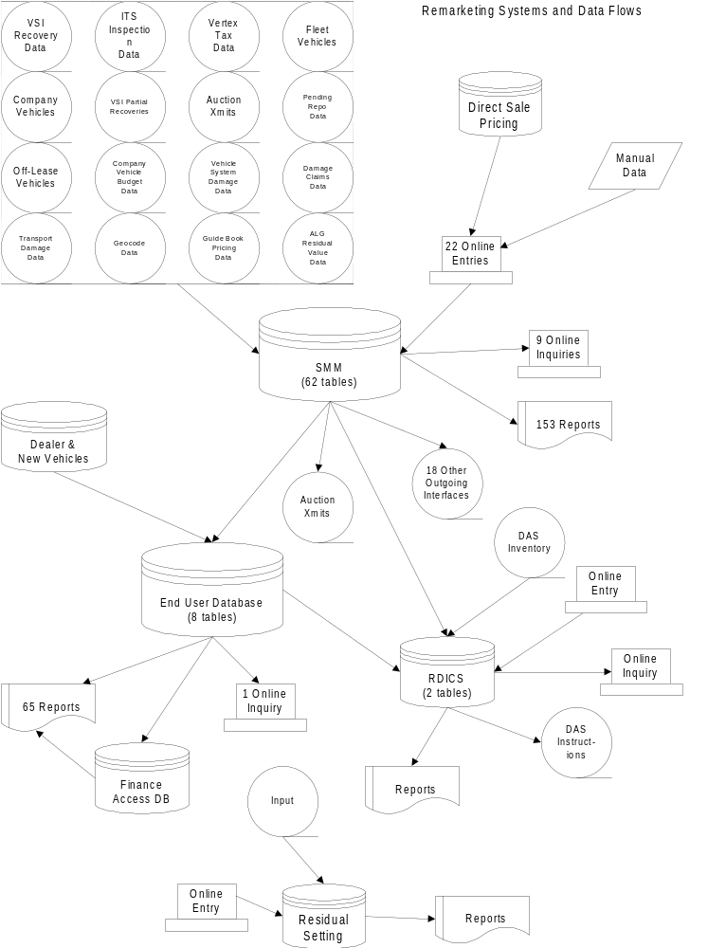
Internal Assessment
Information System Architecture

Slide 13
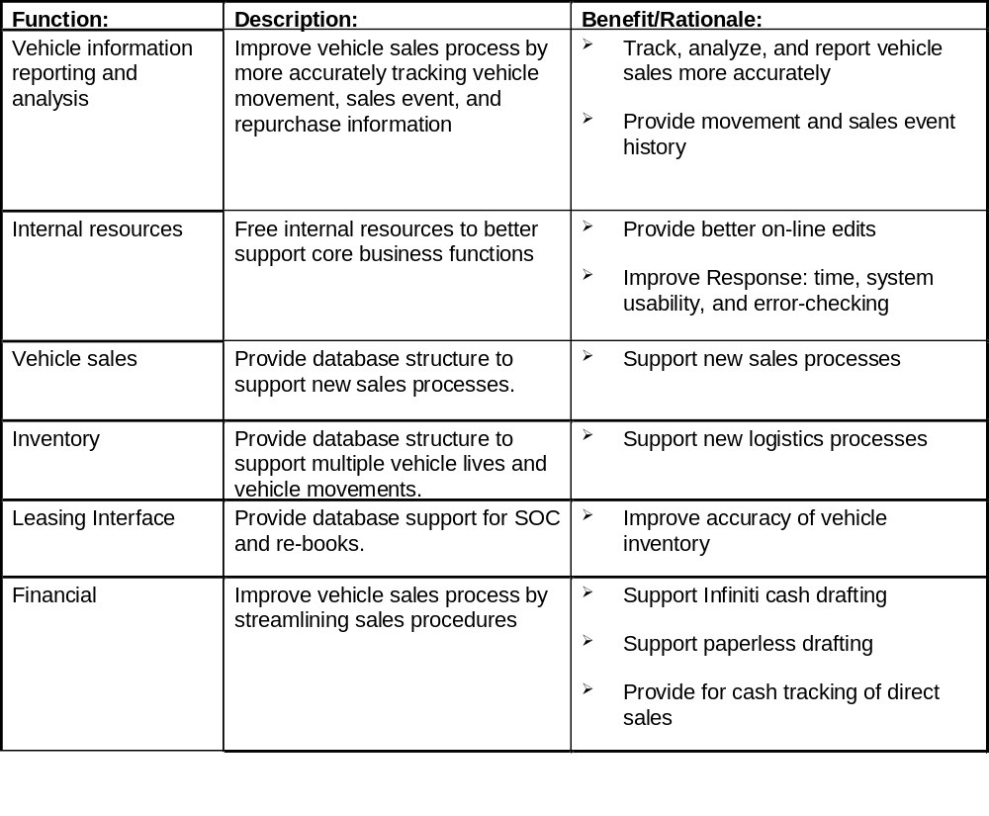
Internal Assessment
Project Inventory - Recently Completed Projects

Slide 14
Internal Assessment
Project Inventory - In Progress Projects
Function:
Description:
Benefit/Rationale:
Accounting Inventory
Clarify exceptions and automate
➢
Ensure accurate journal entries and
Reports
resulting General Ledger journal
eliminate manual process
entries
NNA Tax Report
Provide VIN-level discrepancy
➢
Enable NNA Tax to validate General
Validation
report of NNA Tax versus NMC
Ledger balances and respond to tax
Accounting reports
authority inquiries
Sales Event Unwind
Modify unwind programs to
➢
Preserve data critical to proper
ensure appropriate audit trails
inventory calculation
(prevents loss of sales event data)
Sales Update
Implement capability of updating a
➢
Simplify exception resolution process
Capability
lease vehicle from “in service” to
and support accurate inventory
“sold by a business source” or
reporting
“out of service”
➢
Allows update of vehicles incorrectly
identified as “in service” as a result of
NNN data issues.

Slide 15
External Assessment
Deliverable Objective:
Identify the external information systems trends and pressures that may have an impact on the information systems plan for the enterprise and ultimately business units.
Deliverable Components:
Competitive assessment
Technology trends and challenges
Impact on IS Strategy
Key Considerations for Deliverable Development
The scope should depend upon the cost and level of effort involved in conducting surveys, performing research, and analyzing the information. However, the need to obtain some degree of understanding of external market and industry IS issues should not be ignored.
The following types of questions should be addressed whether the effort is formal or less rigorous:
  How does the enterprises’ use of information technology measure up vs. the competition today?
  What have competitors been ale to accomplish, and how much are they investing to do it?
  Are the differences in the deployment of in formation systems important to customers, suppliers, and other key business partners?
  Where is the competition, and the industry in general, heading or investing regarding new or existing applications of information technology?
  What does the enterprise need to plan for from an information systems point of view, in order to maintain or improve the future business competitiveness an flexibility?
  What information systems strategic planning issues do external factors and trends highlight?

Slide 16
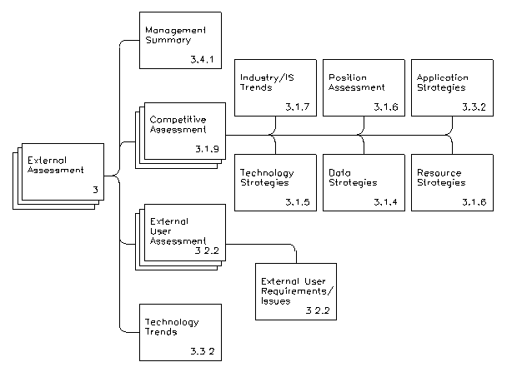
External Assessment
Example Outline of an External Assessment

Slide 17
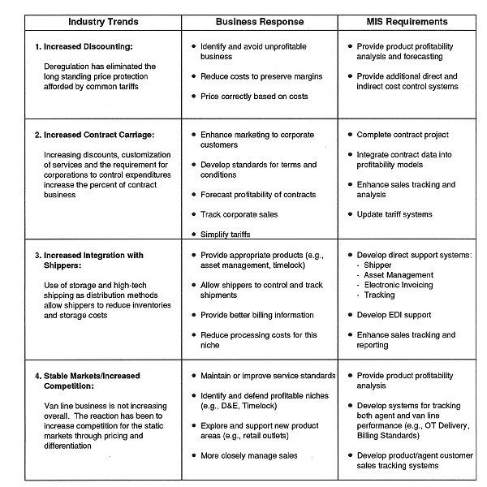
External Assessment
Industry Trends and Response Chart

Slide 18
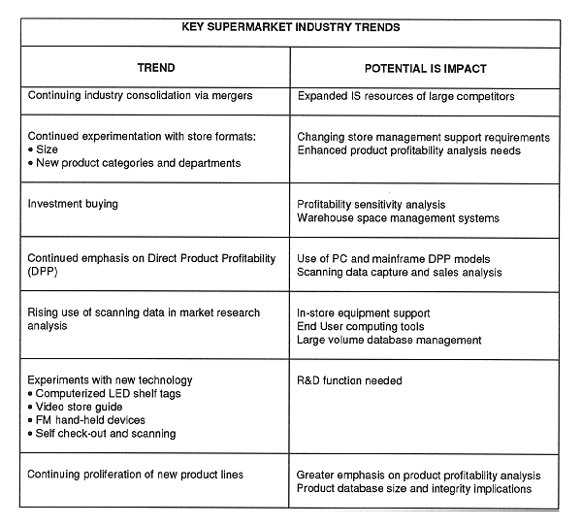
External Assessment
Industry Trends and IS Impact Chart

Slide 19
Project Descriptions
Deliverable Objective:
Provide high-level descriptions of project opportunities. Opportunities arise from gaps identified from assessing the business strategy, internal environment, and external environment.
Deliverable Components:
Project name and managers
Applications impacted
Anticipated cost range
Key requirements, objectives, benefits, issues and dependencies
Key Considerations for Deliverable Development
The accuracy required in the project descriptions should be sufficient to evaluate alignment with the business and technology strategies and interdependencies amongst project alternatives.
A reasonable benefit and cost range is identified to assist in prioritizing projects within the proposed portfolio.

Slide 20
Project Descriptions
Example Project Descriptions
Project Stream: Logistics
Project: Accelerated Collections
Business Project Manager: <Add Name>
Vendor Project Manager: To be determined
Application Platform: <Add Application Platform>
Estimated Cost Range: $190,000 - $380,000
Requirements:
  Collect dealer payments by check through a bank lockbox
  Provide means for automatic dealer drafting
Key Objective / Benefit:
  Reduce need for working capital by collecting dealer purchase payments as quickly as possible.
Key Issues / Dependencies:
  None

Slide 21
Project Descriptions
Example Project Descriptions
Project Stream: Marketing
Project: Off-lease Customer Management
Business Project Manager: To be determined
Vendor Project Manager: To be determined
Application Platform: Purchased / New client/server application
Estimated Cost Range: $1,500,000 - $4,000,000 (excluding purchased hardware and systems software)
Requirements:
  Calculate cost of providing incentives to early turn existing lease customers
  Create analytical tools for dealers to use in selling to existing lease customers
  Electronically provide dealers with information about existing lease customers
  Provide off-lease telemarketing intelligence to dealers
  Report dealer performance in selling to existing lease customer portfolio
Key Objective / Benefit:
  Provide dealers and home office the tools needed to market to off-lease vehicle customers.
Key Issues / Dependencies:
  Resolve a number of business issues including use of direct customer negotiation and coordination.

Slide 22
Strategic Alignment Analysis
Deliverable Objective:
Determine the IT strategies critical to ensuring the realization of the business unit strategic plan
Evaluate the degree to which current and propose projects support both the business unit strategic plan and the business unit IT plan
Create a vehicle for communicating various project’s strategic impact
Deliverable Components:
Business unit strategy/IT strategy correlation matrix
IT strategy/IT initiative correlation matrix
Key Considerations for Deliverable Development
Business unit and IT strategies must be clearly articulated and structured so that relationships between the different strategies can be demonstrated
Current and proposed projects must state their objectives so that their alignment with specific strategies can be determined
Unless it has been specifically stated, all strategic objectives will be assumed to carry the same degree of importance

Slide 23
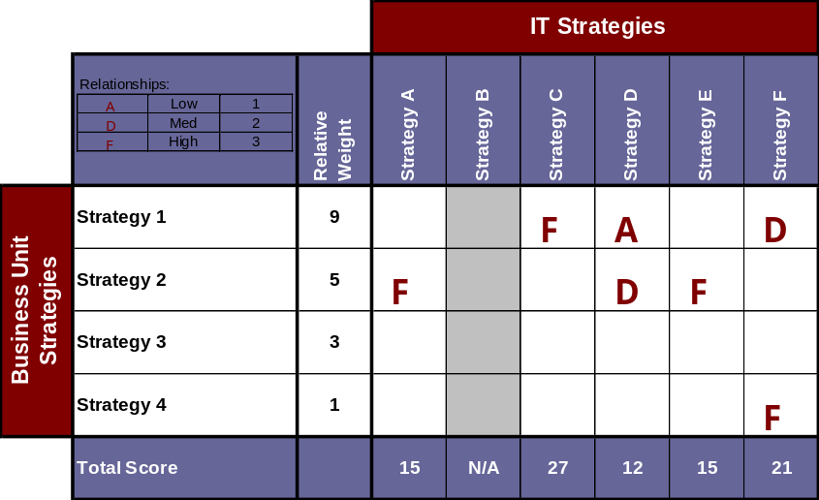
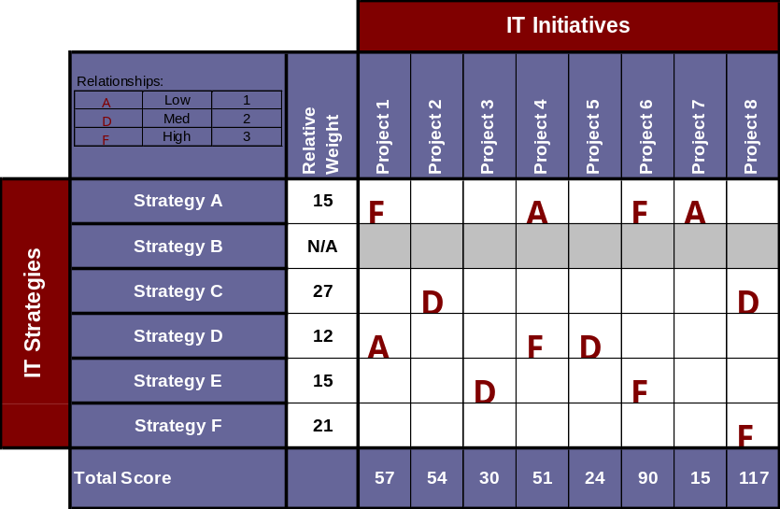
Strategic Alignment Analysis
Portfolio prioritization begins with the evaluation of the degree to which each initiative impacts the achievement of the business units strategic objectives
First, the business units strategic objectives are mapped against IT strategic objectives to determine the degree of correlation
Next, the business units initiatives are evaluated for their contribution to strategic objectives, deriving end scores which indicate program impact across all strategies
.
4
.

Slide 24
Portfolio Cost Benefit Summary
Deliverable Objective:
Calculate a high level financial feasibility for projects in the portfolio
Rank projects based on their ability to provide financial gain to the business
Deliverable Components:
High level cost benefit review
Summary of costs and benefits for all projects in the portfolio
Key Considerations for Deliverable Development
Larger projects will be assumed to have begun a detailed cost benefit analysis while smaller projects would be expected to have started a benefits listing with estimation of costs in the key categories
Given that not enough detail would have been collected by this point in the IT lifecycle to provide an accurate estimation of costs and benefits, ranges for each should be determined
There may be projects that generate a negative cost benefit calculation that should remain in the project portfolio but these projects should be marked to show continuing inclusion by indicating a regulatory or other requirement

Slide 25
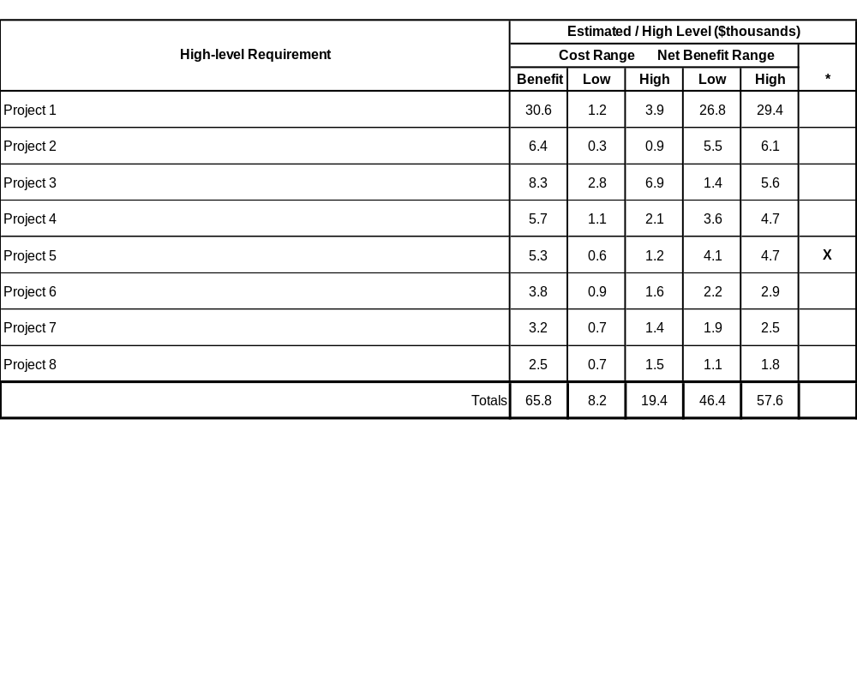
Portfolio Cost Benefit Summary
The second step in portfolio prioritization is a financial feasibility ranking using cost benefit analyses developed for each current and proposed project.
* = Regulatory Requirement

Slide 26
Portfolio Prioritization
Deliverable Objective:
Determine relative weighting among projects based on their ability to support strategic objectives and meet hurdle rates for return on investment
Provide a means of visually communicating an objective ranking of IT projects
Deliverable Components:
Portfolio Prioritization Matrix
Key Considerations for Deliverable Development
It should be assumed that projects, other than those that fall under some regulatory or other requirement, will not be placed on the matrix that do not meet financial hurdle rates or that do not support the business units strategic objectives
Projects of greatest priority will fall in the upper right hand quadrant and will decrease in priority as the projects fall downward and to the left on the matrix
Additional information such as project risk can be shown on the matrix by adjusting the size of the project bubbles and changing their color. This information can be useful in helping business unit decision makers

Slide 27
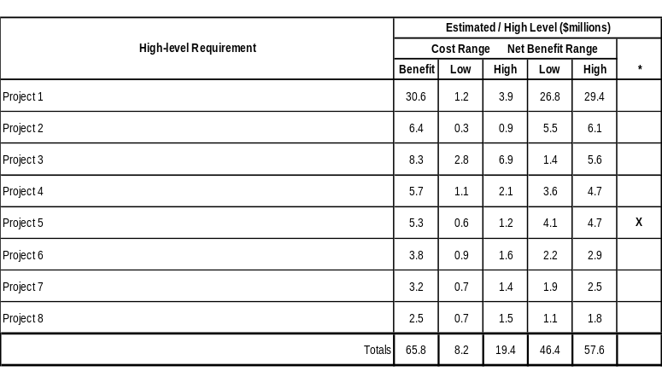
Prioritization Framework
The strategic alignment and portfolio cost benefit analyses provide information that can be used to determine the relative priorities among projects in the portfolio.
Program
Program
High
Project 8
Project 6
STRATEGIC IMPACT
Project 1
Project 2
Project 4
Project 5
Project 3
Low
Project 7
Low
Cost Benefit Value
High

Slide 28
Project Interdependencies Matrix
Deliverable Objective:
Identify projects whose support of strategic objectives and overall financial objectives may be minimal but whose success determines the success of other projects
Determine what projects must be completed before others are completed or initiated
Deliverable Components:
Interdependencies matrix
Key Considerations for Deliverable Development
Projects can be dependent, enabling, both or none.
Projects may exist that, while their success does not completely determine the success of another project, will have strong influence on the other project. It may be worth documenting the degree of impact if projects more often than not have impacts on other projects

Slide 29
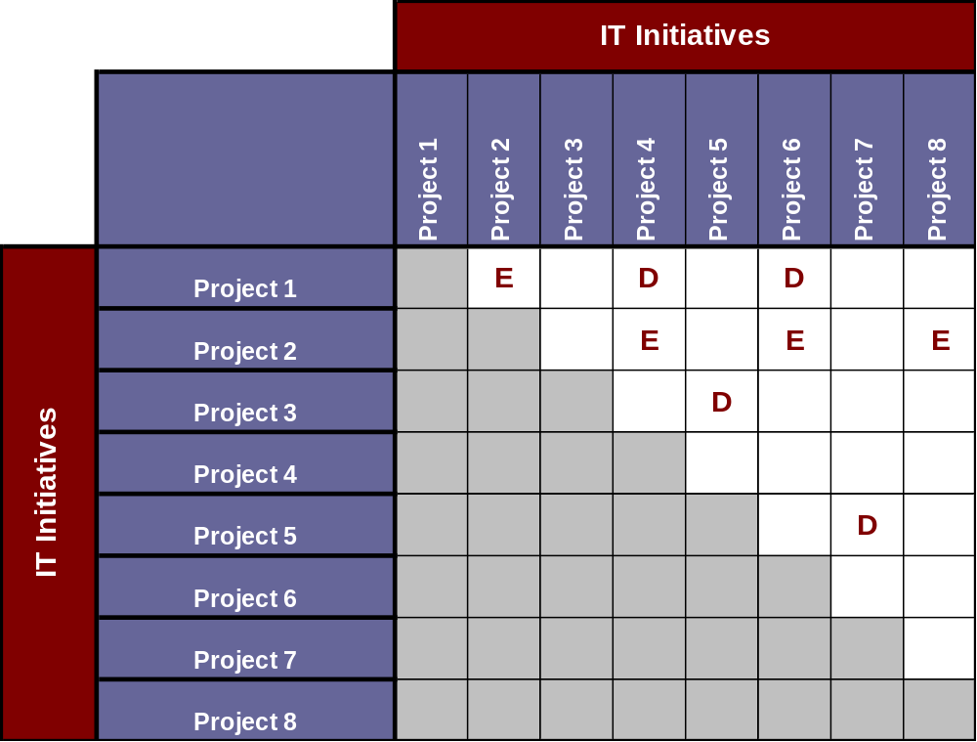
Project Interdependencies Matrix
In order to determine what project must be completed and in what order, enabling and dependent project are identified.

Slide 30
Portfolio Plan & Resource Schedule
Deliverable Objective:
Show high level timing of projects within the portfolio
Identify current and future period IT project resource requirements
Provide an input into the decision process as changes occur to strategic objectives, existing projects, corporate and other business unit IT strategies
Deliverable Components:
Portfolio Resource Planning Schedule
Key Considerations for Deliverable Development
The level of detail provided on the schedule (length of planning horizon, breakdown on costs, types of resources) should be customized depending on the requirements of the business unit
Interdependencies can be shown similar to MS Project by drawing lines between the dependant projects
The development of the schedule should flow from the workplans of current projects with details for proposed projects coming from previous planning process deliverables

Slide 31
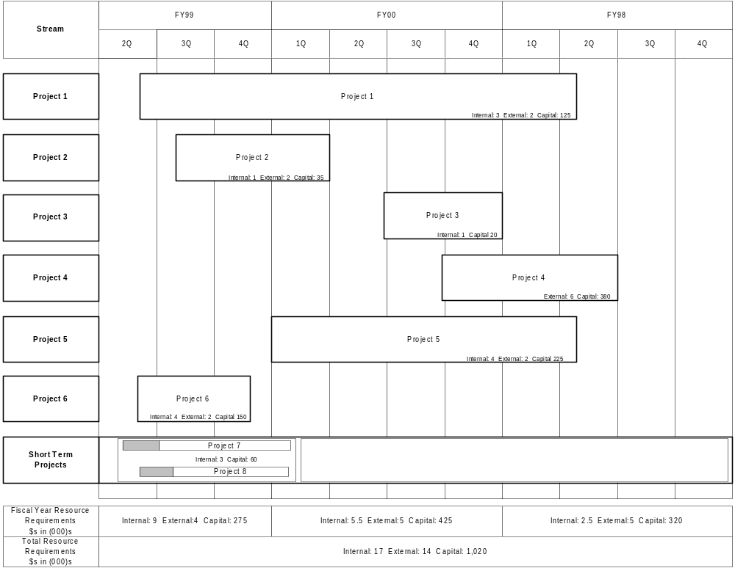
Portfolio Plan & Resource Schedule
Once project interdependencies have been identified, the business unit can gain a longer term perspective on the timing and realization of project benefits and view the resource impacts of the IT plan.

Slide 32
Appendix
Example Questions

Slide 33
Clarity Of Vision
Example Questions
Strategic Use of Information
Business strategies are ad-hoc or not clearly defined.
IT support of the perceived business vision is unclear.
Business and IT strategies are defined, but done independently of each other.
Business strategies are defined and clearly communicated.
IT strategies are clearly in support of the goals and initiatives of the enterprise.
  Is the business vision and direction clear?
  Is it communicated, supported and practiced by the business leadership?
  Is there a common understanding of the vision across all functional departments that leaves no room for interpretation?
  Has the business vision been decomposed into specific objectives? Have the objectives been translated into I&T initiatives and are actionable plans in place to support?
  Is the type of information that is required to support the business strategy understood?
  During the business strategy planning process, is the way in which information can contribute to and change the business strategy considered?
  Can business leaders describe the role of information and technology in achieving business objectives? Can business leaders describe how the IT organization supports the business today? Tomorrow?

Slide 34
Market and Industry Focus
Example Questions
Strategic Use of Information
Knowledge of the enterprise's market, competitors, product strategy, industry trends, constraints, and environmental factors is not articulated.
The information needs for understanding the external environment are not defined.
Business and/or IT resource allocations are not synchronized with the enterprise’s external focus.
The enterprise is solely internally-focused.
The external environment is understood but the supporting information and technology requirements have not been articulated.
The business and IT work hand-in-hand to define and implement I&T solutions which improve and strengthen the enterprise’s understanding of the external environment.
The enterprise has a competitive advantage from the externally-focused I&T investments which support.
  Do we currently assess short term and long term Market place trends and factors?
  Are our investments in information and technology consistent with our strategy and positioning in the market place?
  Are our investments in information and technology consistent with others in the marketplace?
  Do the business and IS leadership understand what information is required to create new value in the market? In a different market?
  How can information be used to understand market position real-time? How can it be used to understand competitor positions?
  Do we have information about the failures in our market? Do we use it to ensure appropriate directions and target
  Do we possess unique information that we can use to differentiate ourselves in the marketplace? Do our competition?
  Do we know the information that is required to predict future market size? Do we know how to use it?
  Do we know what information is required to effectively manage our channels?
  Do we know what information or ways of using information can reshape the industry structure?
  Do we know what information or information structures can enhance our ability to innovate?

Slide 35
I&T Business Process Support
Example Questions
Strategic Use of Information
Processes are mostly manual and do not involve significant automation.
It is unclear as to how I&T can improve or streamline the enterprise’s buiness processes.
The business understands that I&T solutions could improve its processes.
The current I&T investments support back-office processes but limited strategic or customer-facing processes.
Business leaders seek IT to help define and implement I&T solutions which improve business processes by converting them from manual processes to information-focused processes.
  Are processes manual (physical) or predominantly automated (information-centric)?
  For the processes which are automated, does I&T support them adequately?
  What is the balance between back-office and customer-facing processes which involve automation?
  Are there opportunities for I&T to automate existing manual processes?
  Are there processes in place between the business and IT to determine how to improve processes through I&T?

Slide 36
Management Information Support
Example Questions
Strategic Use of Information
Investments in I&T are focused on data and technology versus management information.
Information is tactical in nature.
The type of information needed to support management decision-making and the definition of value-producing strategies is not well defined.
The company understands its information needs for management decision-making and strategy definition.
I&T investments support the information requirements for management decision-making and strategy definition.
Management and IT work hand-in-hand to assess future information needs and delivery methods that will support value-producing strategies.
  Is there an understanding of what type of information is required to support value-producing strategies?
  Is critical information readily available to key decision makers?
  How could we qualify the amount of data in all systems vis-à-vis the information and knowledge available to decision makers?
  Is there a general consensus that answers to critical business questions are “out-there” but there is no way to extract the information?
  Is the business transactional in nature? How critical is it to continuously support front-line business operations?
  What are the policies and procedures in place regarding data accuracy, timeliness, quality, form, documentation, etc.?
  Is there any type of continuous steering committee that assess future needs for information and identify potential benefits?

Slide 37
Information/Technology Separation
Example Questions
Strategic Use of Information
Given budgetary or technological constraints, I&T are heavily intertwined and cannot be separated.
The company meets resistance in its effort to disconnect these entities.
I&T are managed independently in some, but not in all areas of the business.
The value and contribution of each is managed individually and each support value-producing business strategies.
  How much of our business data is locked into legacy systems and not accessible through other means?
  Is information available to analysts and decision-makers without intervention of IT for any request?
  What type of information (strategic versus operational) is currently linked to technology? What are the issues with having an information supported, but technology reliant, organization?
  What are the risks and troubles of separating information from technology?
  What opportunities would be enabled by separating information from technology?
  How would technology independence change the way that the enterprise transacts business?
  How would technology independence change the way that IT transacts business?
  How would technology independence change the business strategic planning process?

Slide 38
Technology Strategy Definition
Example Questions
IT Strategy
Technology strategy is defined independently from the business and/or information strategy.
Technology strategy does not support the value drivers of the enterprise and/or the users.
Technology strategy supports the business strategy at a high level, but is not tightly linked.
Business and IT executives work hand-in-hand to define integrated business, information, and technology strategies.
Technology strategy completely addresses the value drivers of the enterprise and/or the users.
Business and IT executives both understand of the role technology strategy plays in supporting business and/or information strategies.
  Does the enterprise define technology strategies? Is it done independently of the business strategy? Is it tightly linked?
  Are value drivers of the business and user community used to drive technology strategy?
  Does an information strategy exist? If so, does the technology strategy support it?
  Does an information strategy exist? If so, does the technology strategy support it?
  How are technology choices made today? What is the involvement of functional areas?
  What are the major criteria of evaluation? How do they relate to business needs?
  In terms of new technology, should we consider the firm as being an early adopter, a majority adopter or laggard.
  How does the company align its technology vision with its long term business needs and objectives? Who participates in such initiatives?
  How does IS communicate the selection of a new technology to the business? Are costs and benefits associated with functional operations and made known to the business?
  How does the firm ensure that technology selection is consistent with its architecture standards?

Slide 39
Current Systems
Example Questions
IT Strategy
Current systems do not meet existing requirements.
Assessments of future systems needs are not articulated.
Current systems meet some or most of current requirements.
The enterprise is considering its future I&T needs.
Current systems optimally support the business as it runs today.
IT and the business have defined plans to mature, update and/or retire the systems over time to support the changing vision.
The business and IT have a mutual understanding of these plans and how they reflect the continuous evolution of business needs.
  Does the functionality of the current systems meet the business needs? Is it adaptable for the future direction of the business?
  Is the technical foundation of the current systems robust and reliable? Is it adaptable for the future business needs?
  Are the current systems aligned with how the business is run today? Do they fulfill today’s business needs?
  Are the current systems aligned with the way the business will be managed in the future? Will they serve as a base for building tomorrow’s functionality needs? Will current systems handle future volumes?
  If the current systems will not fit future needs, is any transition plan in place? How involved is the business in this process?

Slide 40
Flexibility and Adaptability of Systems
Example Questions
IT Strategy
Planned systems do not consider the future business direction and needs.
Planned systems are too rigid that the business cannot respond to unexpected market changes.
Plans have been defined to allow for systems flexibility in response to internal short-term business changes.
The business and IT have defined plans to allow for flexibility and scalability in response to present and future market trends and business changes.
Systems are flexible in responding to unexpected environmental changes.
  Are future systems planned on an ad-hoc basis or are multiple integrated systems planned?
  Do future system plans invariably require major overhauls of existing systems, or are existing systems updated gradually as part of a continuing overall plan?
  How do the current systems technologies compare to those that are available available in the marketplace and commonly leveraged by competitors? How will planned systems compare?
  Do systems consider the future needs of the business? Why or why not?
  How flexible are the systems in design? Can they be changed quickly to respond to unexpected changes?
  How scaleable and configurable are the systems?
  Are processes in place to improve the flexibility of systems?
  Do the business and the IS organization focus regularly on the determining the future needs for business systems? If so, what time horizon is used?
  What drives the future systems planning process, existing technology or business requirements?

Slide 41
Information Accessibility and Accuracy
Example Questions
IT Strategy
Information integrity or accessibility hampers business operations.
Information is reliable but not totally accessible (or vice-versa).
Information is sufficient, accurate, and accessible (i.e., provides the right information to the right people at the right time).
  Is business information tied to specific technologies and not accessible by other means?
  Is information easily accessible by users? Can information be easily extracted from the firm’s data?
  How accurate is the information available to the business user? Does reporting from different systems produce different sets of data?
  Do users rely on the IS organization for new reporting needs?
  Does management have the information that it needs to drive strategic and tactical decisions? Is the quality of the information supporting decisions known and appropriate ?
  Are the operational processes supported by the right information? Is the information supporting the processes accurate, timely, etc?
  How does the organization’s portfolio of information compare to competitors and best practices?

Slide 42
I&T Usability
Example Questions
IT Effectiveness
There is a disconnect between the applications and technology supplied by IT and the needs of the end user.
Applications are hard to learn/use and technology failures impact productivity.
I&T technology and applications aligns itself to the needs of its users to varying degrees. There are some difficult applications to learn/use and some technologies are prone to failure.
Users are empowered by the IT supplied to them. Access to and ability to leverage information are well supported by the applications and technology.
  Does the user interface incorporate personal styles of interaction with systems (e.g., information access preferences, analytic processes, etc.)?
  Do the current systems support both ad-hoc and scheduled reporting?
  Are tools and applications easy to learn?
  Is existing data in a usable format? Can it be separated from a specific technology?
  Do system and hardware failures limit the amount of work that can be done? How often to these failures occur?
  Are tools and applications limited to effective use in certain locations (e.g., dial-up networking, analog modem speed limitations, tools/applications working only on certain PCs)?

